Slide 1

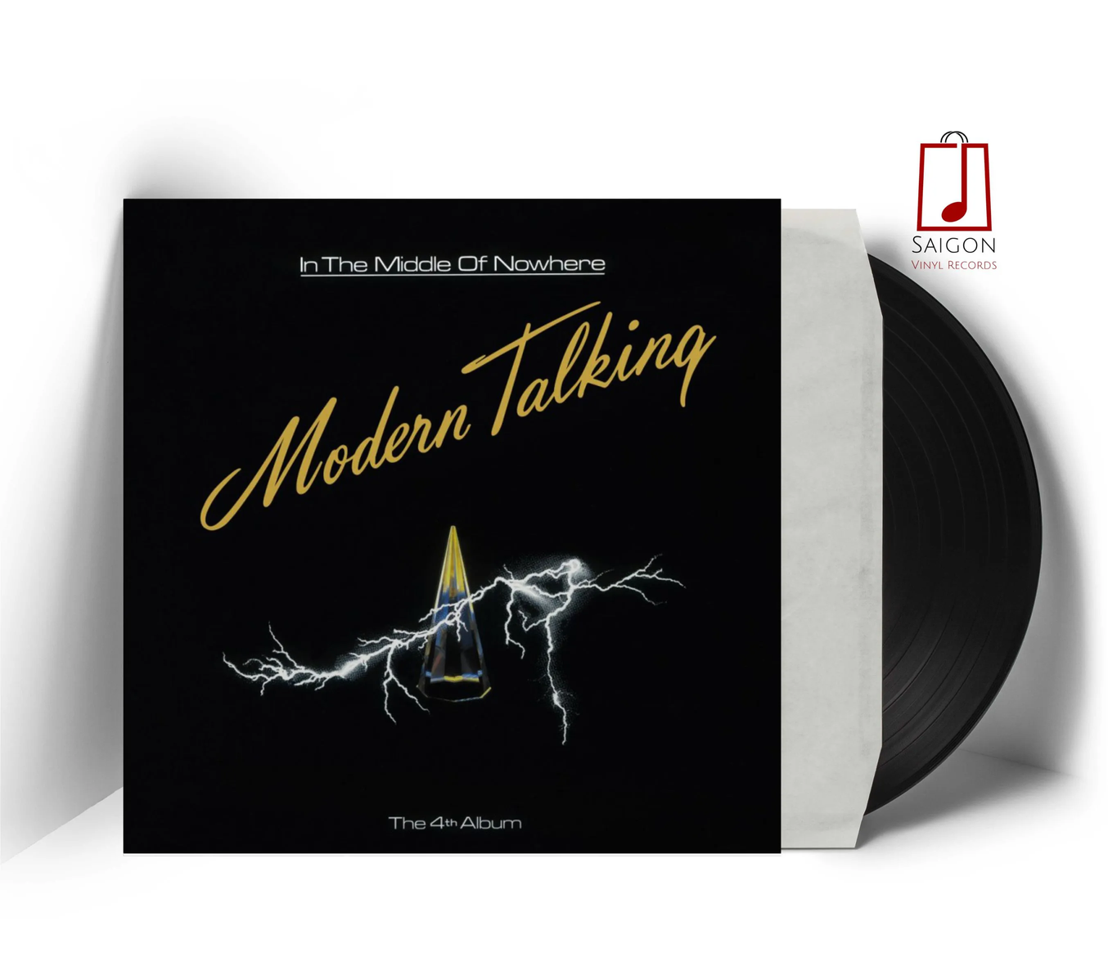
MP
(MUSIC PLAYER)
AI18C/CSD203

Slide 2
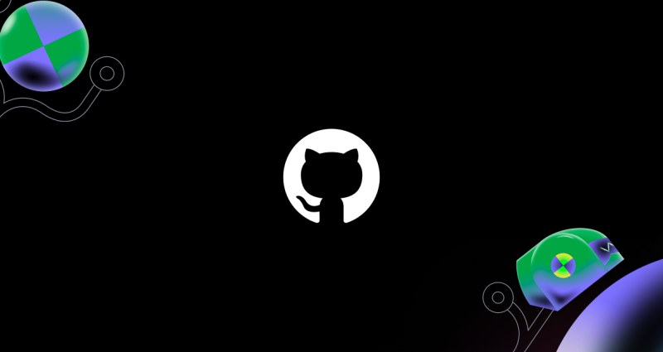
TABLE OF CONTENT
ASSIGN TASKS
IREMIND CIRCULAR DOUBLY LINKED LIST
APPLY THE DS, UI
DEMO CODE, Q&A

Slide 3
ASSIGN TASKS

Slide 4
ASSIGN TASKS
TASK / PROCESS
Mon
Tue
Wed
Thu
Fri
Sat
Sun
Mon
Tue
19
20
21
22
23
24
25
26
27
Brainstorm
60%
Choose the DS
100%
Implement the DS
60%
Design UI, appli the DS
100%
Test code
80%

Slide 5
ASSIGN TASKS
TASK
MEMBER
IMPLEMENT DS
VIET, HIEU, DO
UI/UX
CHINH , THANG
TEST CODE
THANG
MANAGER
CHINH

Slide 6
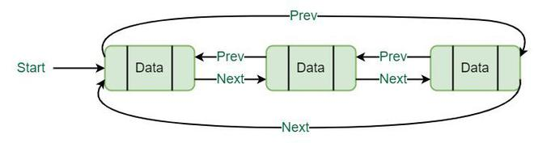
WHAT DATA STRUCTURE DO WE APPLY?
CIRCULAR DOUBLY LINKED LIST

Slide 7
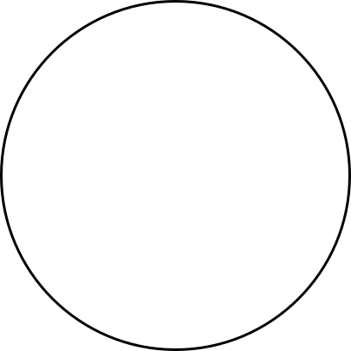

CIRCULAR DOUBLY LINKED LIST
NODE
INSERT(DELETE) BEGIN(END)
TRAVERSE
CHANGE
PREV
NEXT

Slide 8



NODE
NODE
PREV
NEXT
PREV
NEXT
CDLL
NODE
PREVIOUS SONG
PREV
NEXT
NEXT SONG

Slide 9
APPLY THE DS, UI

Slide 10
LIBRARIES USED
tkinter
pygame
time
os

Slide 11
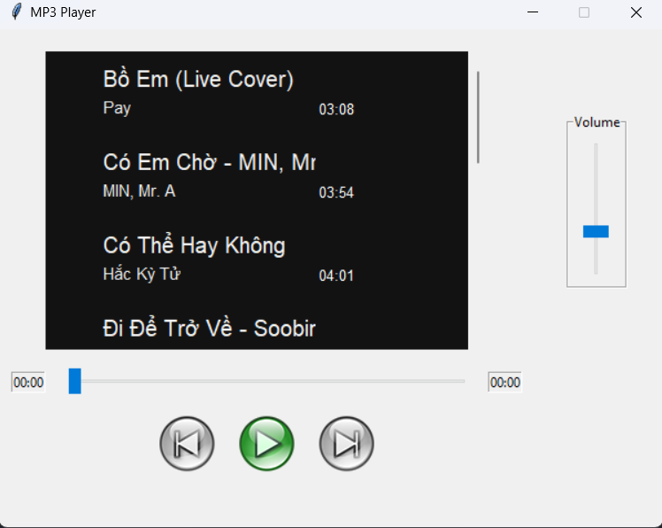
Table
ttk.Scale
time
Buttons
pygame.mixer.music

Slide 12
DEMO CODE
Q&A
THANK YOU

